Slide 1
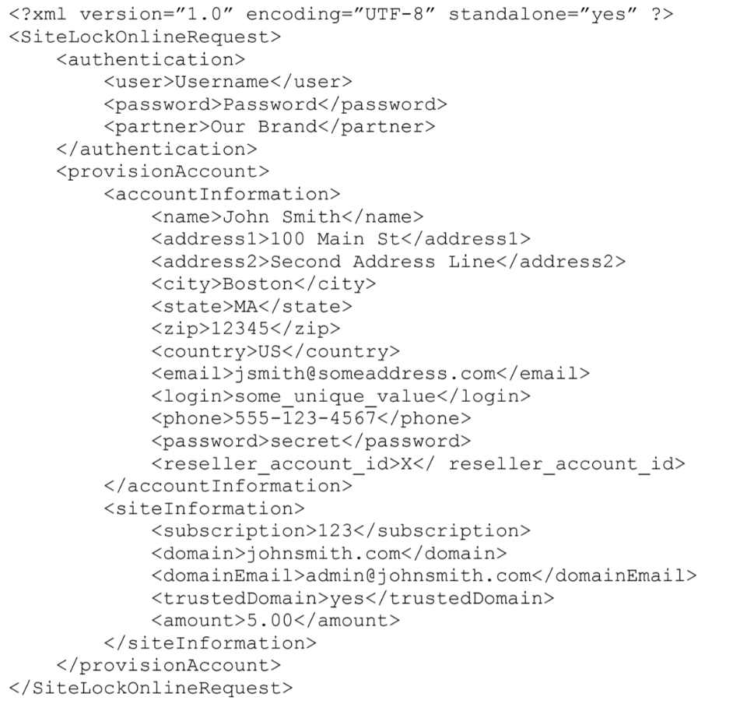
Partner API Overview
API Best Practices
Partner Integration
Easy to integrate SOAP-based API.
Single sign-on (SSO) integration.
Flexible user experience customization.
Customized messaging.
Co-branded dashboard.
Simple invoicing.
Fully automated partner/end user experience via API
Advanced API integration options…
Extensive Flexibility
FULL account management.
Provision and remove sites and products.
Set scan intervals and kick off ad hoc scans.
Automatically configure FTP/SSH settings for SMART.
Automatically retrieve and set DNS settings.
Automatically add/upload SSL certificates.
Automatically update site origin IP during migrations.
Complete cache management for CDN.
Manage whitelist/blacklist configuration for WAF.
Retrieve product/site statistics and display as you wish.
Retrieve account messages and deliver as you wish.
Change/reset user passwords.
Proprietary & Confidential

Slide 2
API Integration Model
API Best Practices
Partner integration via API can be as concise or as advanced as the partner sees fit. Integration can be achieved through a single-phase minimum viable product (MVP) approach, or through up to four short sprints easily manageable through an Agile/Scrum framework.
In a multi-tiered distribution model, Advanced Integration may not be necessary.
Proprietary & Confidential

Slide 3
API Best Practices
Proprietary & Confidential

Slide 4
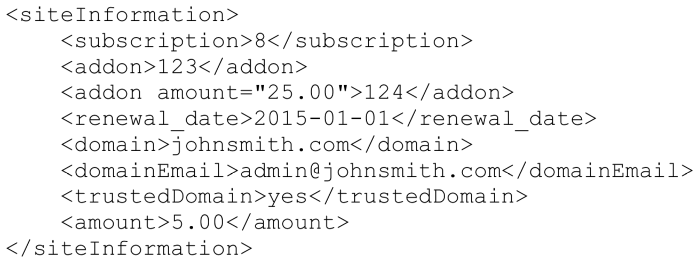
Compound Product Provisioning
API Best Practices
Some products such as SiteLock Prevent (among others) are compound product offerings. Provisioning them involves sending both a <subscription> product ID as well as an <addon> product ID on the next line, indicating that both a SCAN plan and a WAF/CDN plan is included.
Example:
Proprietary & Confidential

